Slide 1
Blindness
Jose Saramago

Slide 2
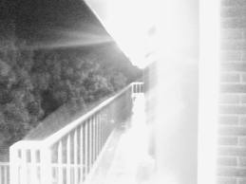

Slide 3
Blindness
In this dystopic tale of white blindness afflicting anyone and everyone, Jose Saramago essentially presents the worst of all “damned if you do / damned if you don’t” situations – the lesser of two evils, if you will.

Slide 4
Blindness
Assuming what the girl with dark glasses states is true – that everyone within the context of this seedy landscape is simultaneously guilty and innocent – the question becomes, in which existence would you rather wallow?

Slide 5
Would you rather?
Be imprisoned with other people?
Be free and completely alone?

Slide 6
Would you rather?
Struggle arduously for all basic needs and be independent?
Be completely beholden to others for all basic needs?

Slide 7
Would you rather?
Eat grossly rotten food regularly?
Starve except for one (1) healthy meal per week?

Slide 8
Would you rather?
Shoot a man possibly infected with a deadly virus and live with the guilt of murder?
Let the infected man escape and possibly doom mankind?

Slide 9
Would you rather?
Starve to death?
Sacrifice your morals for sustenance?

Slide 10
Would you rather?
Make the decision for people to be executed?
Carry out the order for execution?

Slide 11
Would you rather?
Be exposed to an illness and live with the fear of possibly becoming infected?
Live with the illness and hope for a cure?

Slide 12
Would you rather?
Hold power over people due to fear, intimidation, and weaponry?
Have a great power which you cannot share with anyone?

Slide 13
Would you rather?
Bury a rotting corpse with your bare hands, without the aid of a shovel or spade?
Constantly see / smell a body rot while you eat or sit nearby?

