Slide 1
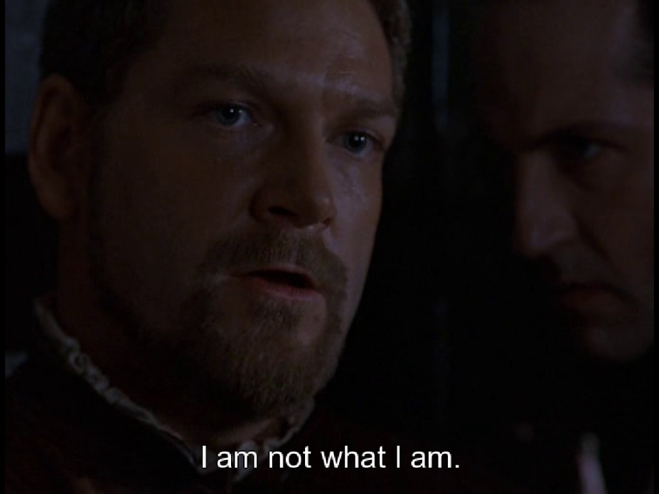
IS IAGO THE DEVIL INCARNATE?
Iago loves evil for evil’s sake because he is the personification of pure wickedness. Simply, he was born that way. From this point of view, Iago needs no motive. He loves to see people suffer and exists only to inflict abuse and horror upon any and all who encounter him. He is the epitome of all that is vile in the world.

