Slide 1
Department of English
Sophomore Course Selection Day
Click the photo below to begin choosing your Junior year English course!!!

Slide 2
Which Way Do I Go?
As a current Sophomore student, you essentially have two pathways to travel in your Junior year at Neuqua Valley High School…the Advanced Placement path OR the College Preparatory path.
To follow the Advanced Placement path, click here! | To follow the College Preparatory path, click here!

Slide 3
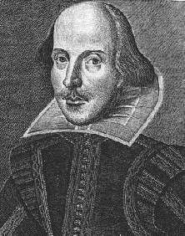
ENGLISH III
ADVANCED PLACEMENT
This year-long course emphasizes the genres of non-fiction and British literature, continues the writing of critical analyses of works studied, and delves deeply into rhetorical analysis. During the course a focus is the preparation for taking the Advanced Placement English Language Examination. Students may receive college credit by qualifying on the Advanced Placement test administered by the College Board.
What major works will I read in English III AP?

Slide 4
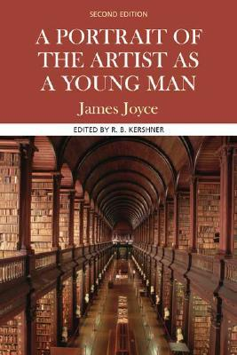
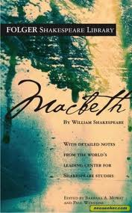
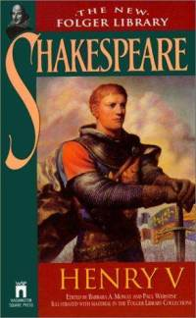
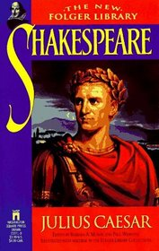
The Major Works of English III AP
To go back and learn about the College Preparatory class, click here!

Slide 5
Comparative Studies
Comparative Studies and Composition is a full-year Junior level course which focuses on viewing life and literature as arguments. This skill-based course will focus on a study of a wide variety of texts representing multiple cultures and genres. Examining literature from various time periods and through multiple genres, students will utilize skills to critically analyze information, synthesize valid sources, develop cogent arguments, and utilize 21st Century skills and use technology to enhance learning.
What will I read in this class?
Go back to the path!

Slide 6
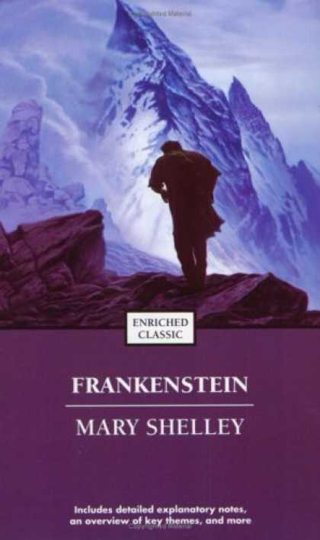
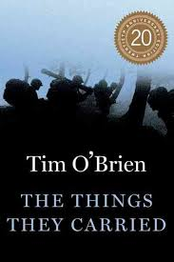
The Major Works of Comparative Studies
All classes read a wide variety of contemporary non-fiction, as well as Tim O’Brien’s The Things They Carried, both a comedy and a tragedy by William Shakespeare, and Mary Shelley’s Frankenstein.
Go back to the path!

