Slide 1
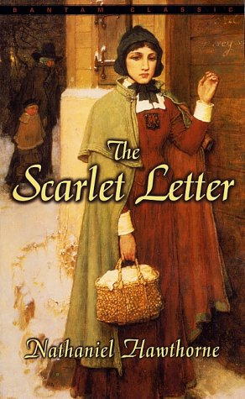
The Scarlet Letter
by Nathaniel Hawthorne

Slide 2
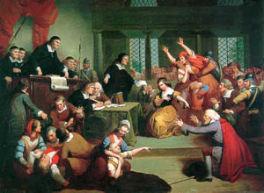
The Life of the Author
The family name is actually Hathorne, but the “w” was later added by Nathaniel to separate himself from his Puritan ancestors.
His first American ancestor, William Hathorne, was a magistrate who sentenced a Quaker woman to be publicly whipped in the streets of her village.

Slide 3
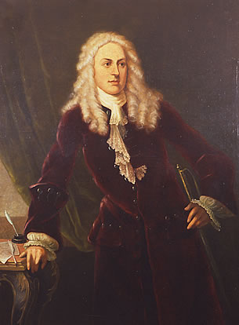
The Life of the Author
William Hathorne’s son, John Hathorne, inherited his father’s demeanor. Known as the “hanging judge of Salem,” he presided over the witchcraft trials of 1692, upon which The Crucible is based. After sentencing one woman to death, she declared, “God will give you blood to drink!”

Slide 4
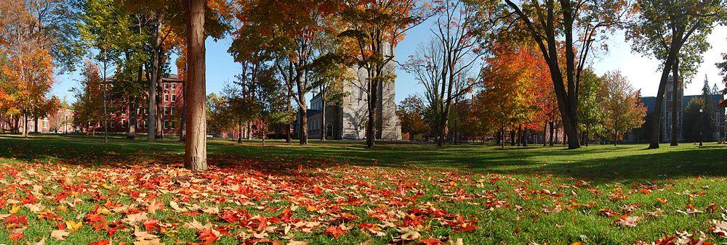
The Life of the Author
Hawthorne’s father, Nathaniel Sr., a seafarer, died on an excursion to Surinam, Dutch Guinea, when Nathaniel was only four. His family lived on the brink of poverty for quite some time, but his mother was able to afford tuition for him to attend Bowdoin College.

Slide 5
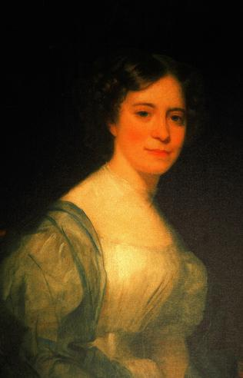
The Life of the Author
Born in 1804 and dying in 1864, Hawthorne enjoyed and long and happy marriage with Sophia Peabody, who literally lived next door to him.

Slide 6
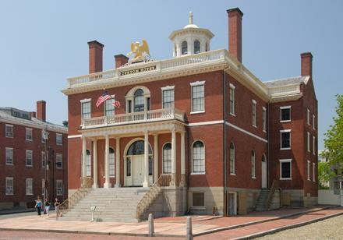
The Life of the Author
During his life Hawthorne was employed through political connections at the Boston Custom House and as surveyor of the port of Salem. He lost these positions when a change in political parties prompted his dismissal.

Slide 7
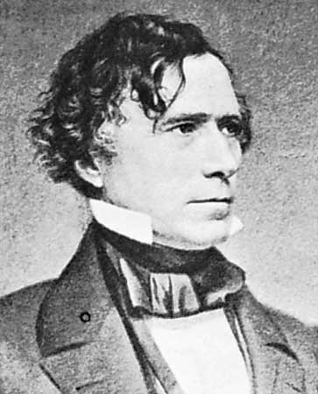
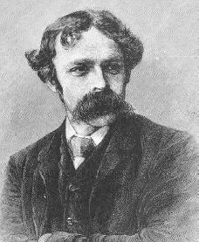
The Life of the Author
Despite his literary success, Hawthorne could never fully support his family through the written word. He gained several non-literary positions, including an American consulship in England provided by his college friend Franklin Pierce, then President of the United States.

Slide 8
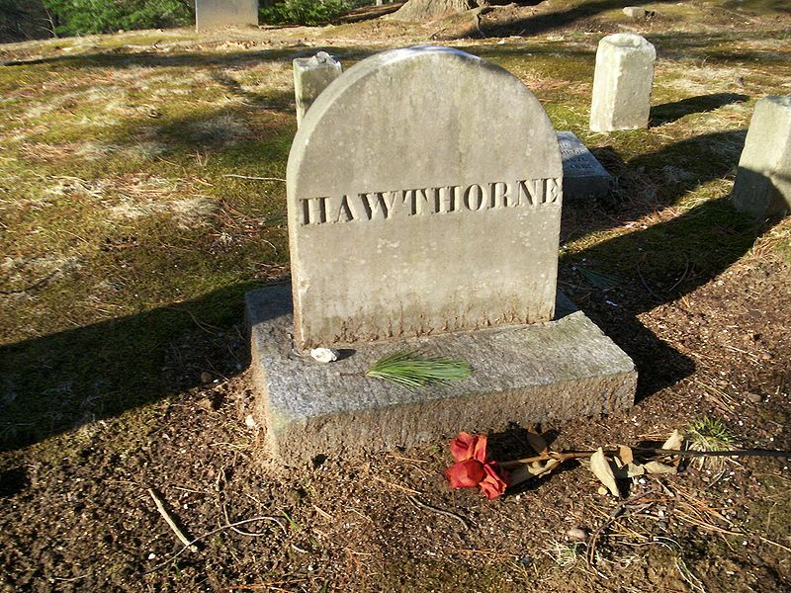
The Life of the Author
Hawthorne died of a heart attack in his sleep while on a tour of New Hampshire.

Slide 9
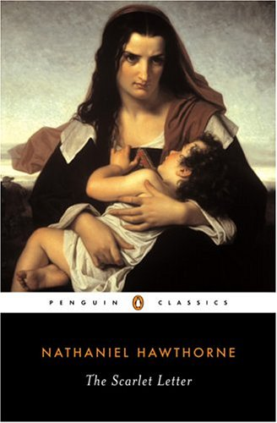
The Novel
The novel was originally published in 1850. Hawthorne only spent one year actually writing the novel.

Slide 10
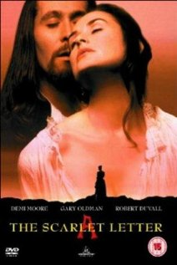
The Novel
The novel is begun with a “revenge-essay” entitled “The Custom-House.” The essay accomplished a dual purpose; it achieved his political revenge by depicting his enemies as extremely lazy fools, while also serving as the prologue to The Scarlet Letter. The essay explains, in a bland and overly-detailed manner, how the narrator came to find a mysterious scarlet letter.

Slide 11
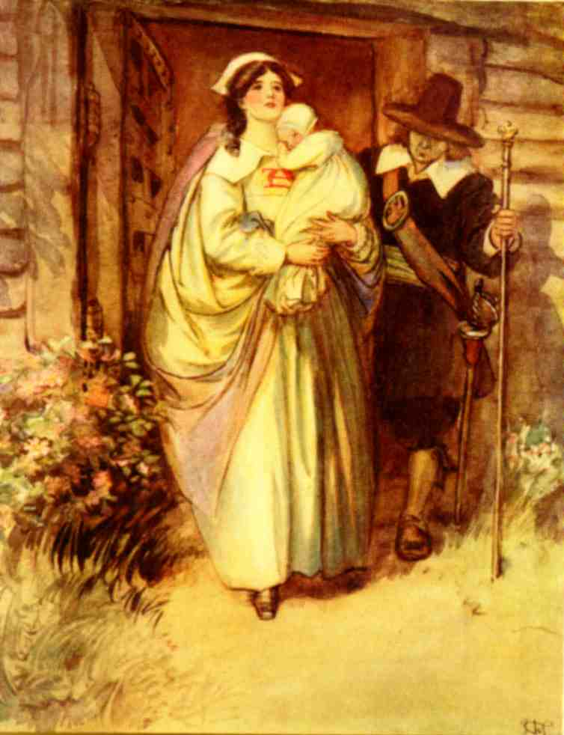
The Novel
The novel was an immediate success, selling 4,000 copies in a mere ten days. The novel was enormously popular because it delved into topics not ordinarily discussed in the printed, or even the spoken, word; in 1850 adultery was quite a taboo subject.

Slide 12
The Novel
The literary community wrote raving reviews of the novel, and the limited controversy of the subject matter dwindled.
The Scarlet Letter is often referred to as America’s first true psychological novel.
Henry James, another great American novelist, declared the novel, “the finest piece of imaginative writing yet put forth in America.”

Slide 13
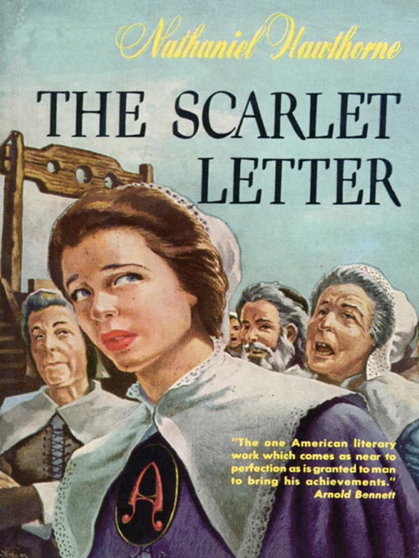
The Novel
The novel focuses on sin and guilt, and their effect on the individual and society. Hawthorne, however, is sure to clarify that there are distinct forms sin can take; those of passion and those of principle.

Slide 14
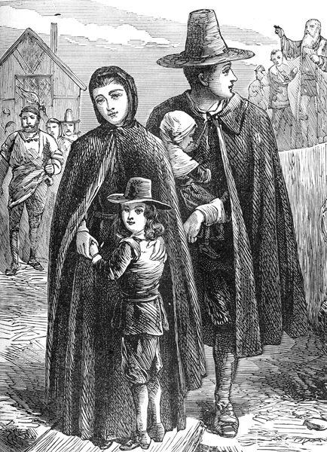
The Puritans
Puritans wanted to “purify” the Church of England by ridding it of Roman Catholic rituals and influence.
Left England in the 1600’s due to religious persecution.

Slide 15
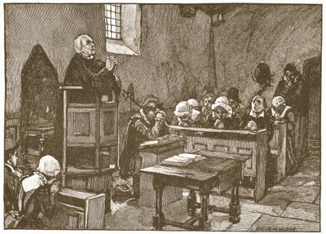
The Puritans
Believed in a Theocracy, or government by religion, thus they made laws that governed private morality.
Opposed overt pleasure and a strong focus on the arts, and suspected excessive joy and laughter as symptoms of sin.

Slide 16
Tenets of Puritanism
God rules ALL things.
Predestination: God has already planned everything.
Providence: God intervenes on Earth.
Since the fall of Adam and Eve, all humans are depraved and deserve damnation.
Through God’s mercy, people are saved through His grace and NOT by their own works.
God is revealed through and in the Bible.

Slide 17
